Slide 1

A testbed for convective-scale NWP and its application in moisture analysis
Jin Lee, David Lee, Vinod Kumar, Susan Rennie, Fiona Smith, Andy Smith, Peter Steinle, UKMO

Slide 2
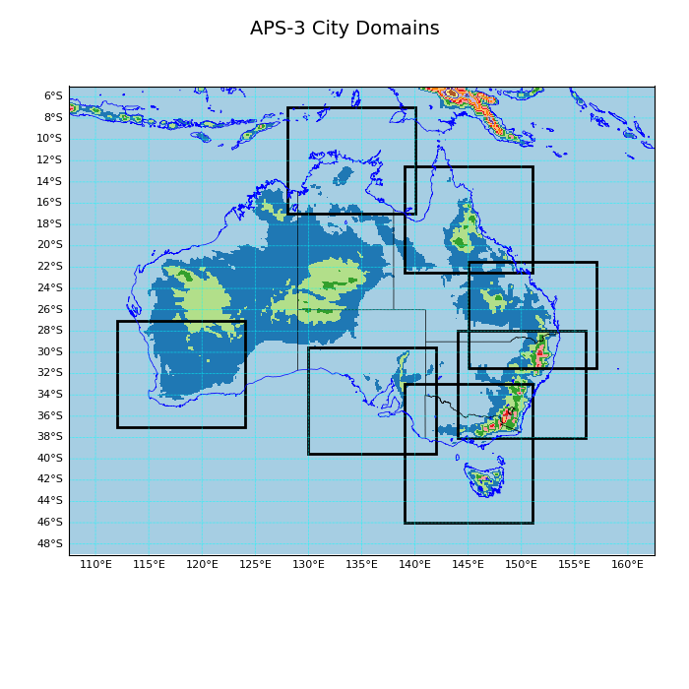
Testbed at NCI in support of Bureau's operational city models
Operational ACCESS-C3 (APS3)
Horizontal gridspacing of 1.5 km and explicit convection
4-dimensional variational (4DVAR) assimilation scheme uses conventional and remotely sensed observations
APS4 upgrade
Test various science configurations – both model physics and data assimilation
Comprehensive set of evaluation tools

Slide 3
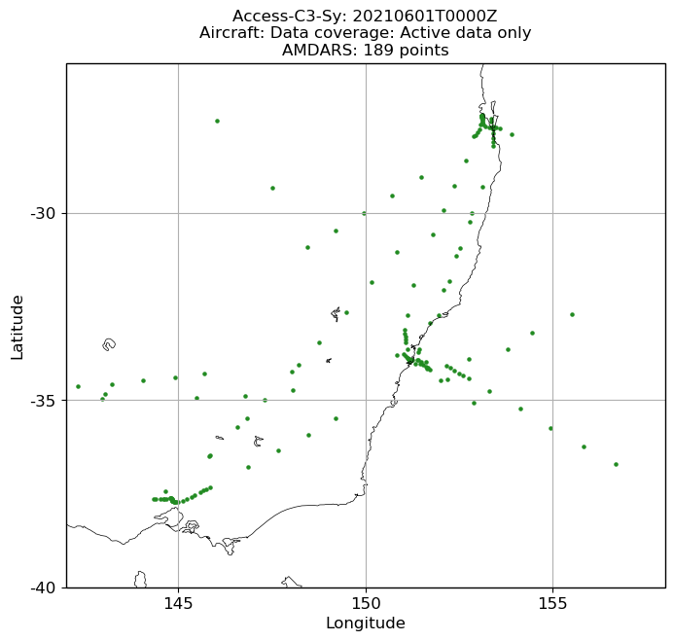
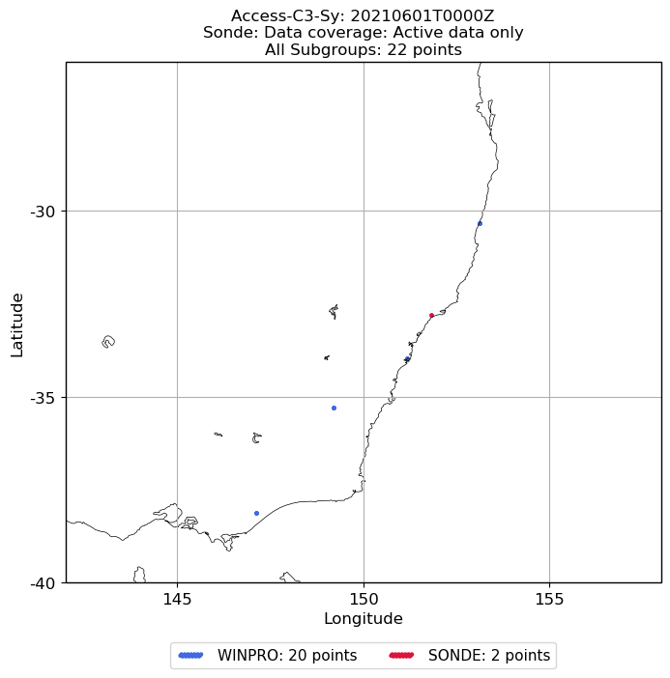
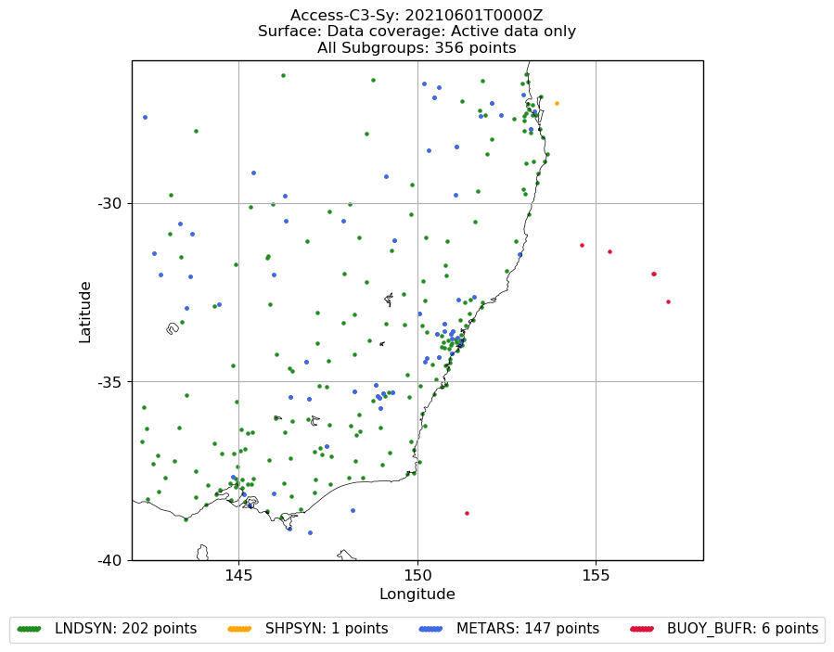
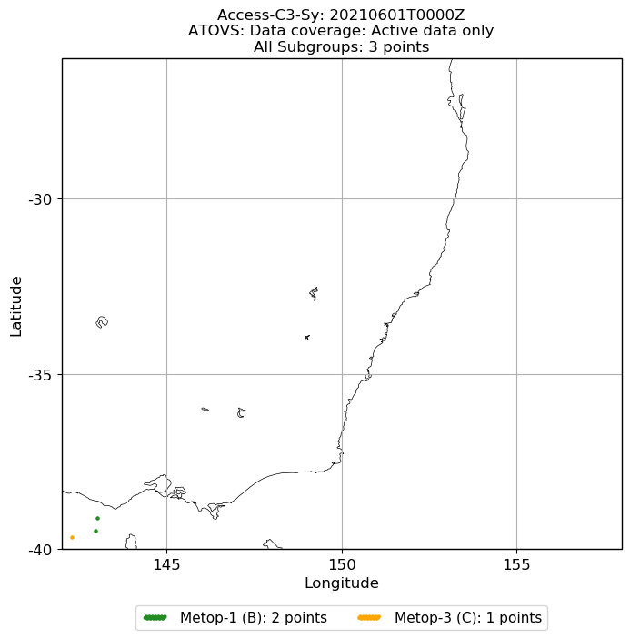
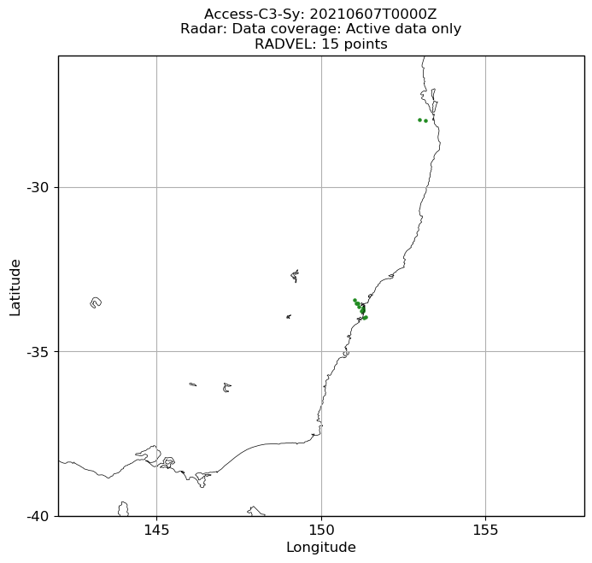
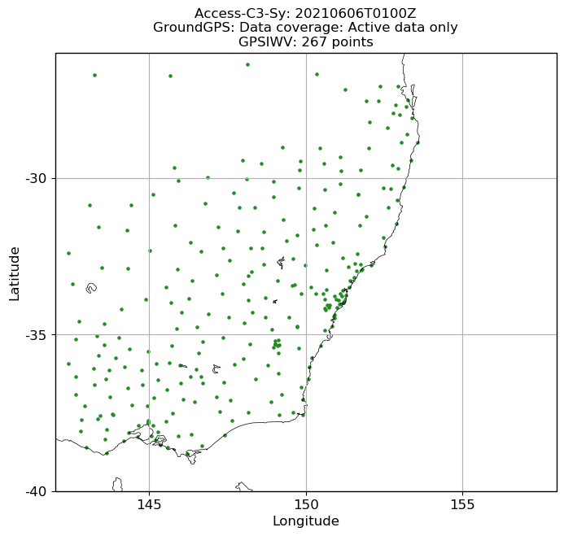
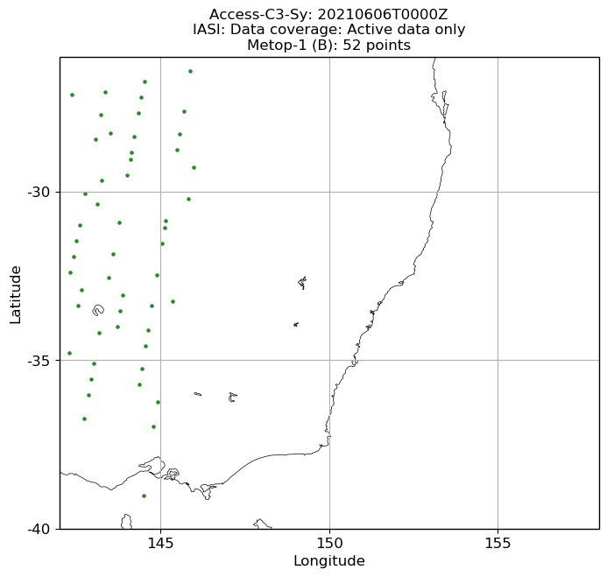
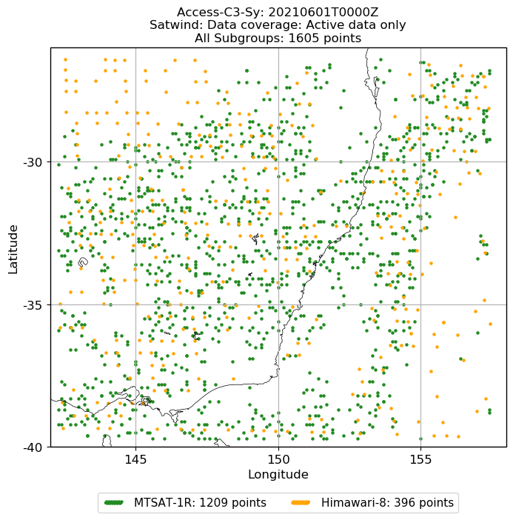
Data denial experiment: remove all remotely sensed observations
Remove satellite radiances, AMVs, scatterometer, Ground GPS, Doppler radial winds
aircraft
sonde
surface
ATOVS
Doppler radar
Ground GPS
IASI
AMV

Slide 4
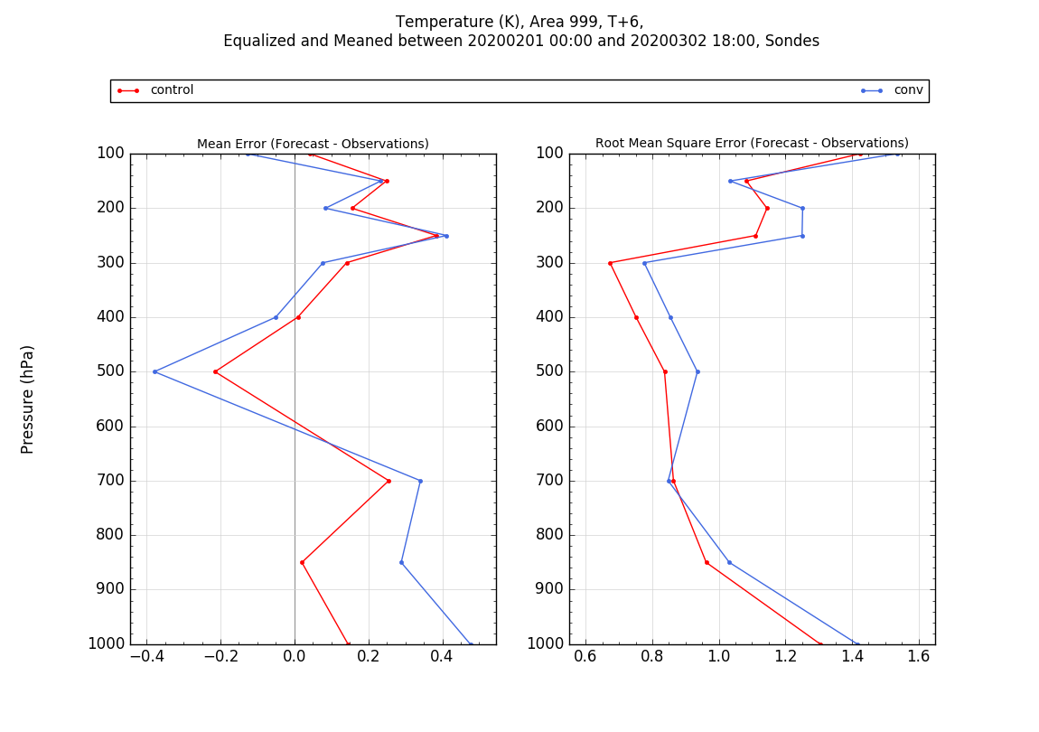
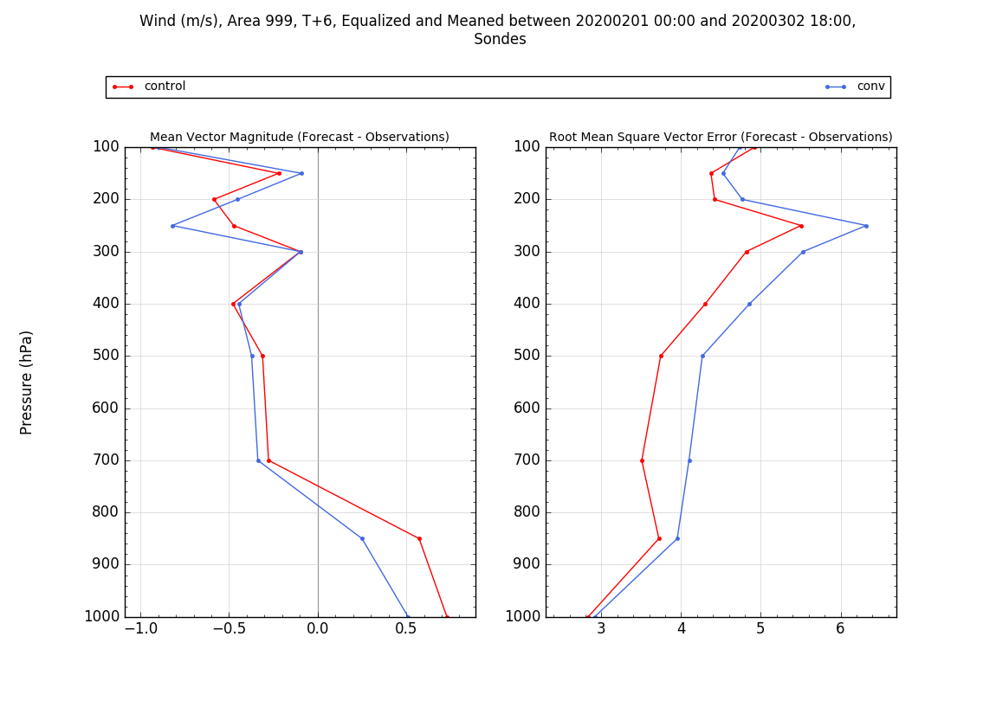
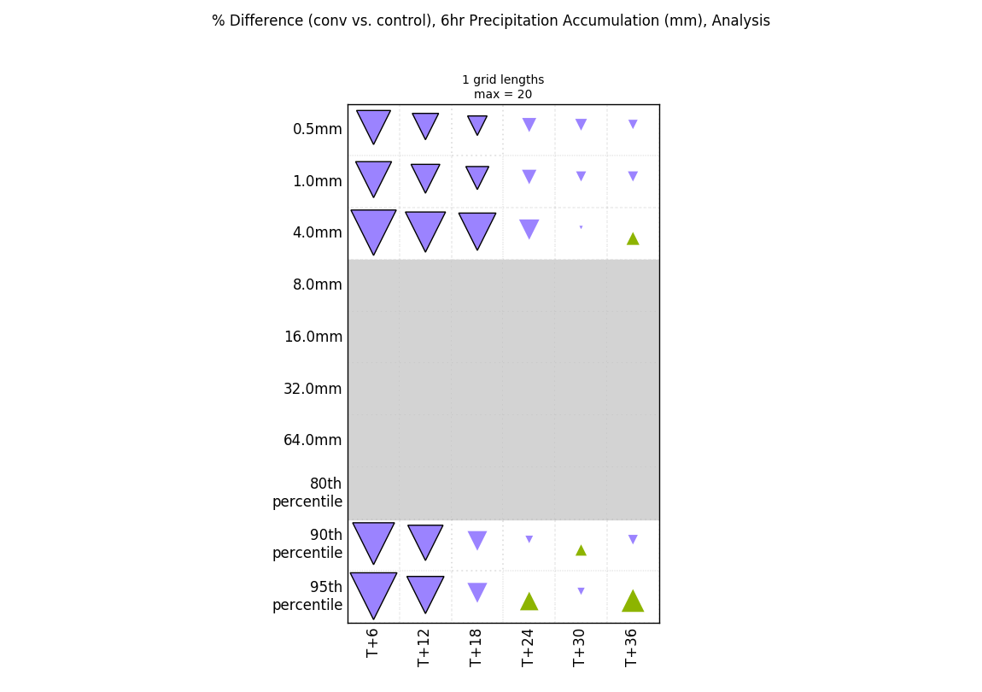
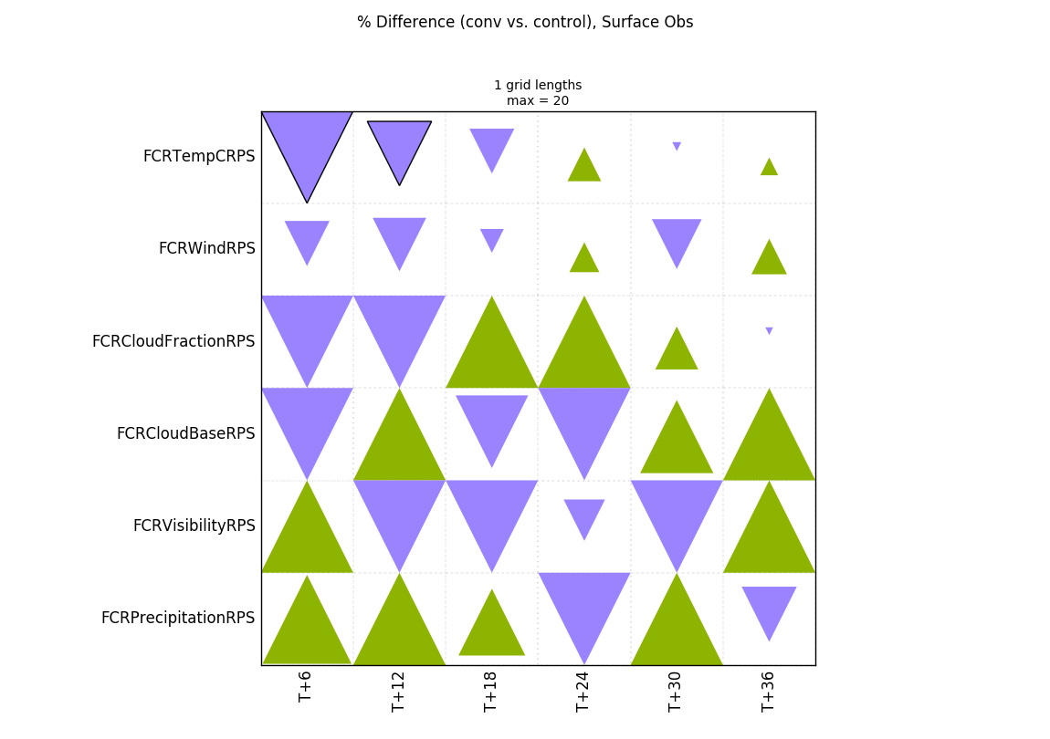
Evaluation of data denial
+6-hour forecast T vs. sonde
+6-hour forecast wind vs. sondes
RPS/CRPS – probabilistic metrics with forecast neighbourhoods and single observations
Fractions skill score using
GPM rainfall estimate

Slide 5
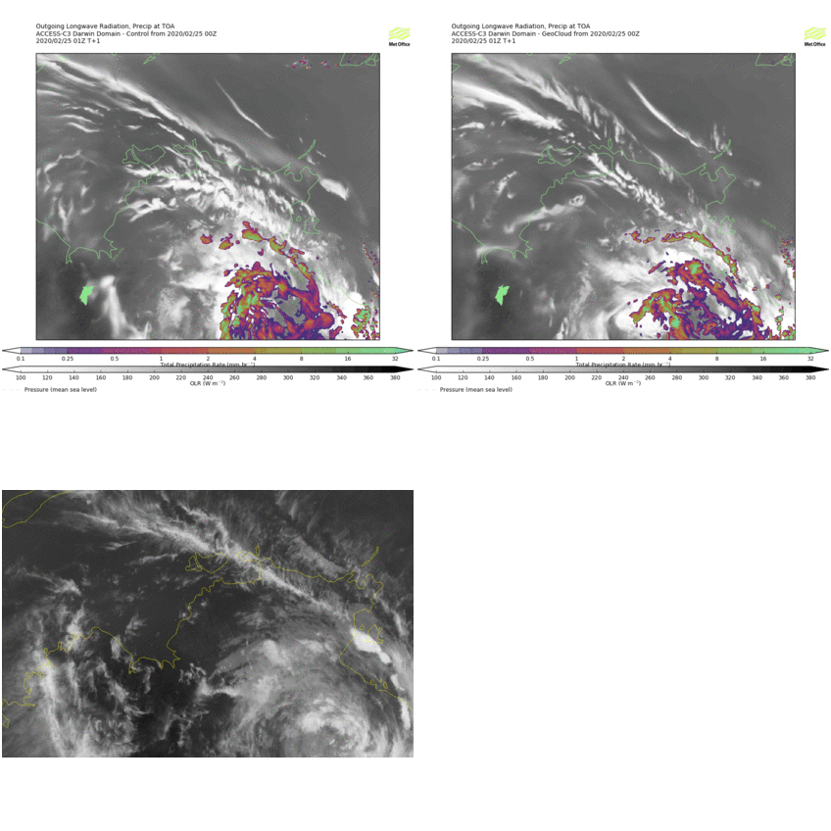
Assimilation of cloud observations
Control
GeoCloud
GeoCloud assimilation: cloud-top pressure and cloud fraction are used to modify humidity variable
Himawari8

Slide 6
Summary:
Testbed for trialing convective-scale NWP is now available at NCI
Trial suite and evaluation tools are working correctly
Data assimilation trial of cloud information (GeoCloud) using the testbed is under way

